Slide 1
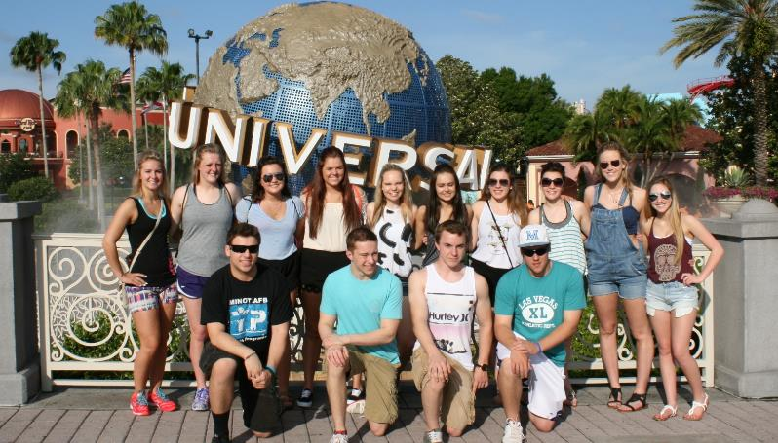
MHS Chapter

Slide 2
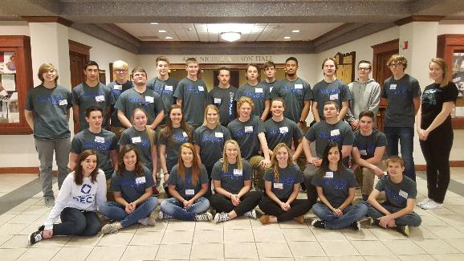
Who Can Be Members?
All Students Enrolled in Marketing
All Students Enrolled in Management

Slide 3
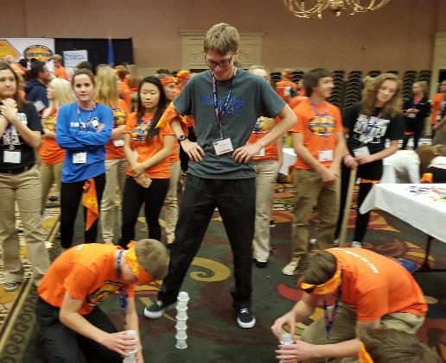
Membership Dues
For Students Enrolled in Marketing:
No Cost to Students
$12.00 Fee – Paid by MHS DECA
$12.00 DECA T-Shirt – Paid by MHS DECA

Slide 4
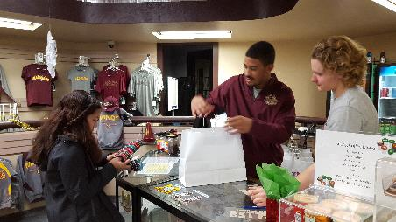
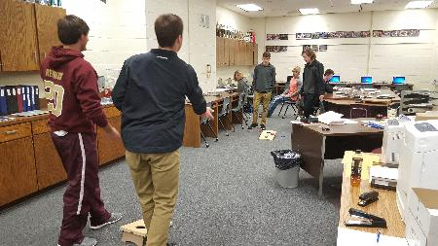
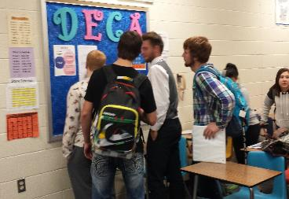
MHS DECA
Involvement is not required, but recommended. Through your involvement you can gain many benefits!

Slide 5
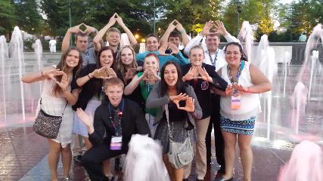
MHS Membership Benefits
Attend Conferences – 4 options
Earn up to ½ of Conference Costs paid by MHS DECA
Two $500 Scholarships awarded by MHS yearly
Dues paid by MHS DECA
Organize and attend Social Activities
Officer Leadership Opportunities
Gain hands on work experience in store
Excellent for a Resume and Reference

Slide 6
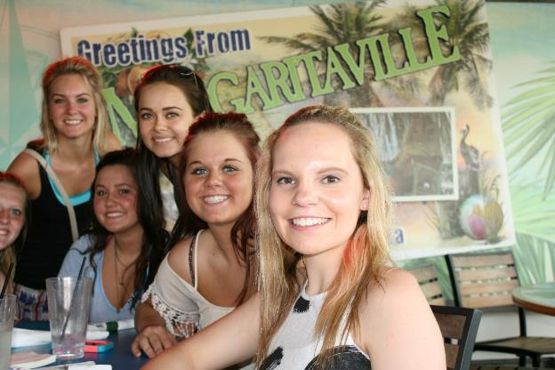
Minot Chapter Officers
Chapter President
Vice President
Social Media Specialist
Event Coordinator
Secretary
Reporter
5 Class Representatives will be elected

Slide 7
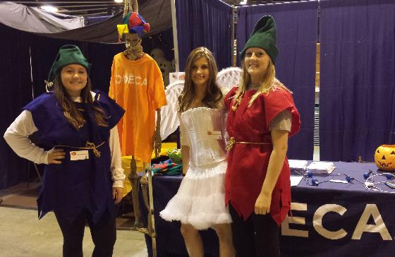
Membership Benefits
Students active in MHS DECA chapter activities can earn up to ½ of Conference Costs paid by MHS DECA
Amount earned is based on your involvement and contribution to MHS DECA
Officers and Reps must attend 6 of 8 chapter meetings

Slide 8
Professional Points
You earn Professional Points for activities you participate in. Processional points determine the amount paid by MHS DECA for conferences.
Volunteering for projects & activities posted on the bulletin board
Attending socials & meetings
Participating in T-Shirt and Dress Days
Fundraising Projects
Community service projects

Slide 9
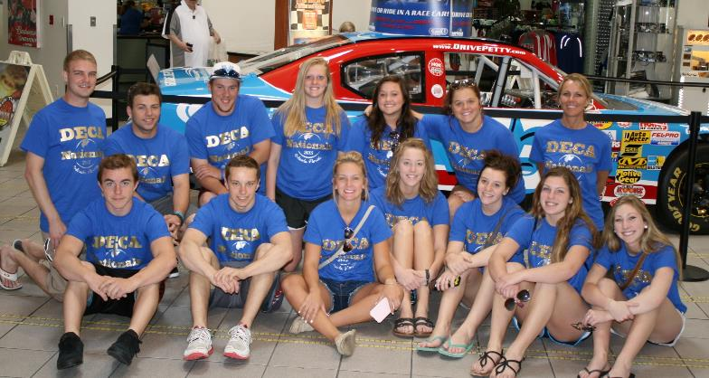
DECA Conferences
Daytona Speedway Tour

Slide 10
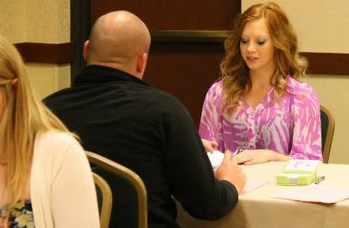
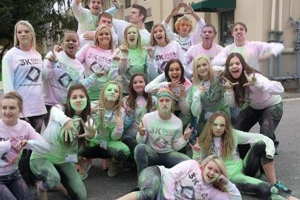
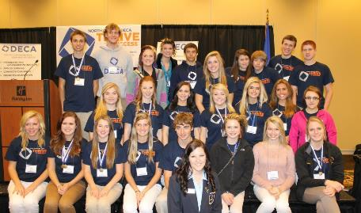
Fall Leadership Conference (FLC)
Available to all Students - Cost $75.00
Recommended for new students as an introduction to DECA
Students pay as low as $35 if active members
Fargo, ND October 23-24

Slide 11
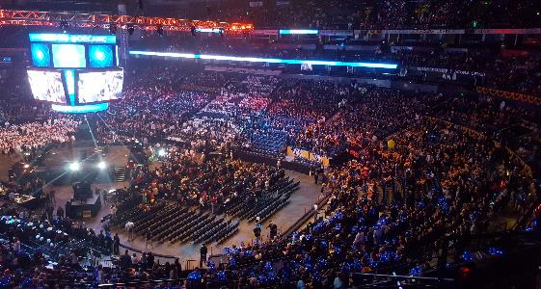
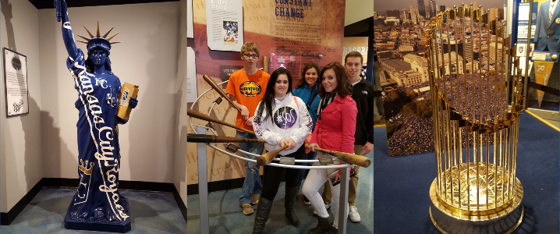
Central Region Leadership Conference (CRLC)
Available to Officers and class reps
Estimated $1100: students pay as low as $550 if active members
Milwaukee, WI, December 9-11

Slide 12
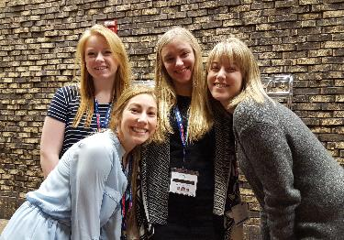
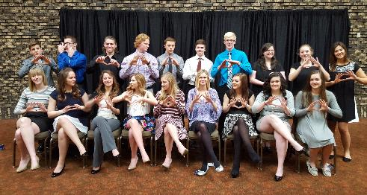
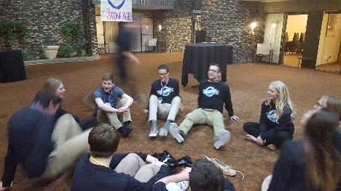
State Leadership Conference
Available to all students (must attend to make it to Nationals)
Cost approximately $120 per student
Students pay as low as $60 if active members
Bismarck, ND Sunday March 5 - 7

Slide 13
State Conference Events & Activities
Role Play Events (test + role play)
Individual and Team Written Events
Chapter Written Projects
Leadership Workshops
Virtual Business & Stock Market Game
Running for State Office for Next Year
Travel, tours, sporting evetns and Concerts

Slide 14
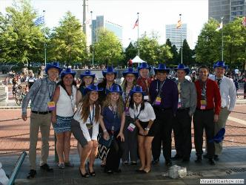
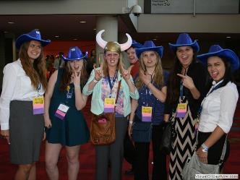
International Career Development Conference (ICDC)
Must attend State Conference and place 1st or 2nd in your event
Approximate cost $1300, students pay as low as $650
Nashville, TN April 22-April 26

